Slide 1
Kafka – 102
Made by a group that learned it recently ;)

Slide 2
Agenda
Resume workshop 1
Start or resume the Code task from workshop 1
Add Schema registry
Wikimedia
Producer & Consumer
Add Schema registry
Kafka Connect
Kafka Rest Proxy

Slide 3
Resume workshop 1
If you have any questions, please reach out to us.

Slide 4
Short break

Slide 5
Schema Registry
https://github.com/fortedigital/cg-kafka

Slide 6
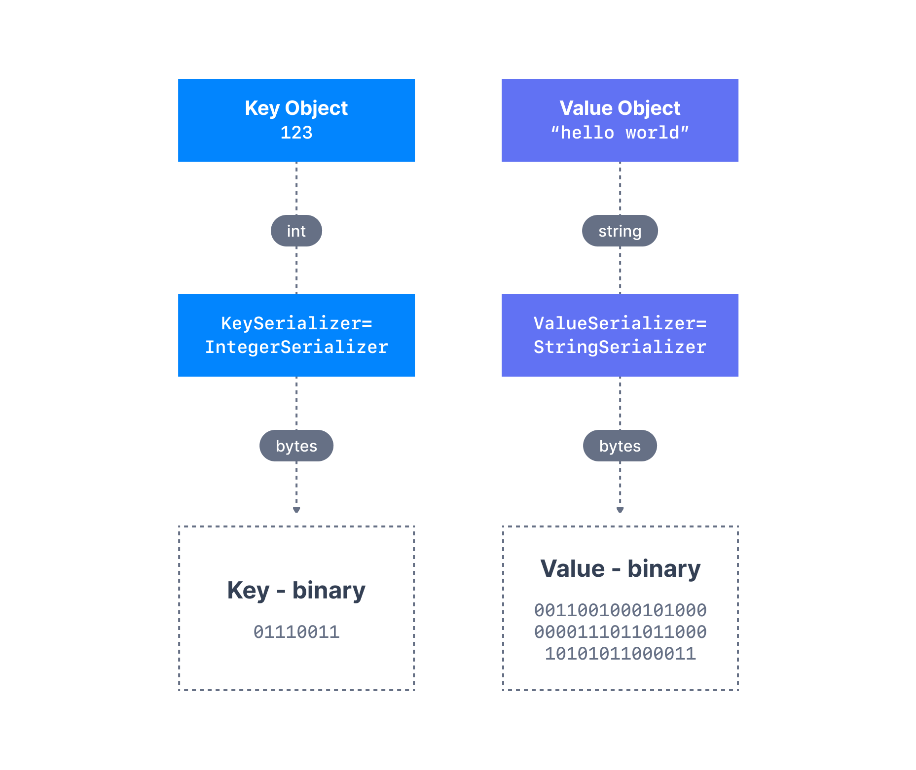
Producer – Message Serializers
Kafka only acceps and sends bytes as input and output
Seralization is used for key and value
Common Serializers
String(incl. JSON)
Int,Float
Avro
Protobuf

Slide 7
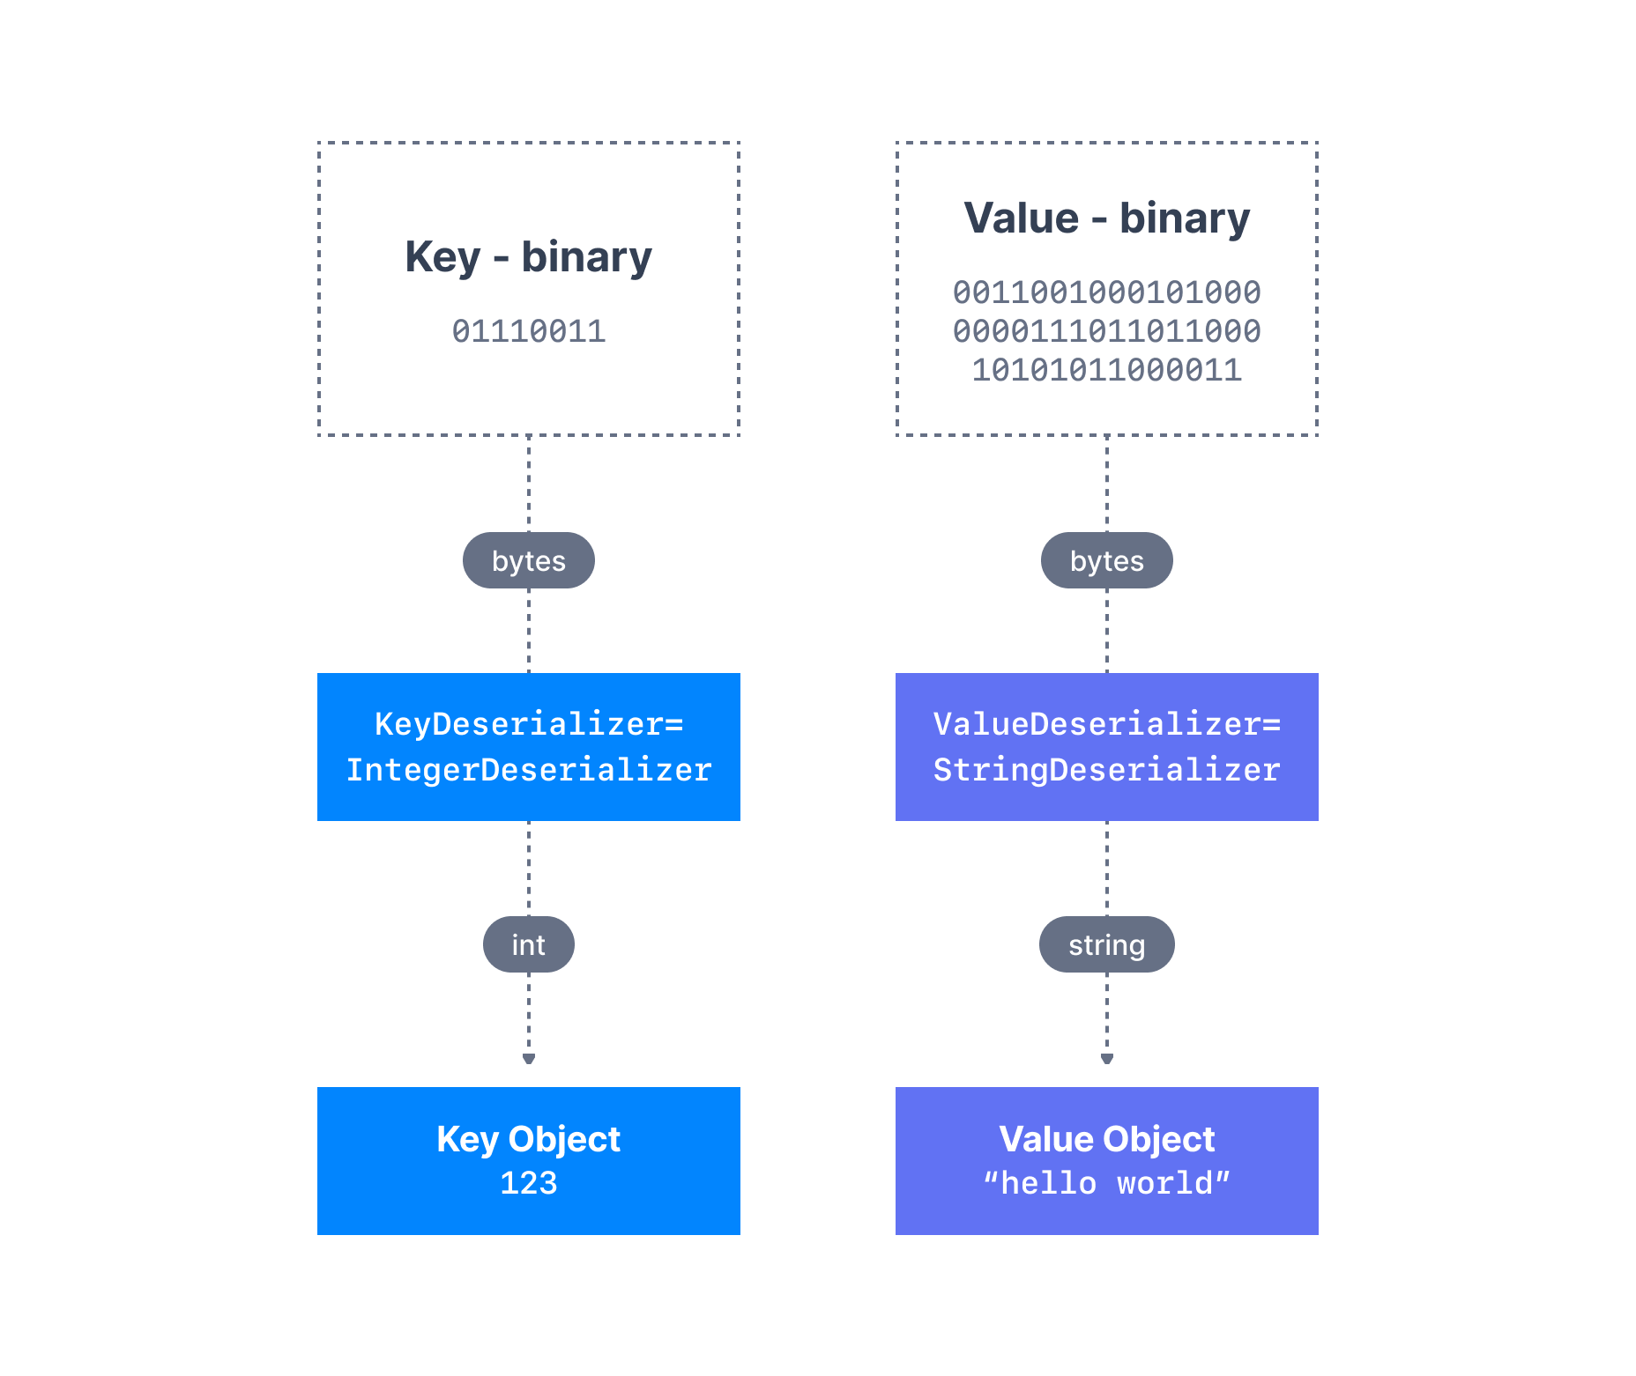
Consumer Deserializer
Deserializer is used for value and key
Common Deserializer
String (incl. JSON)
Int, Float
Avro
Protobuf
The serialization / deserialization type must not change during a topic lifecycle (Create new instead)

Slide 8
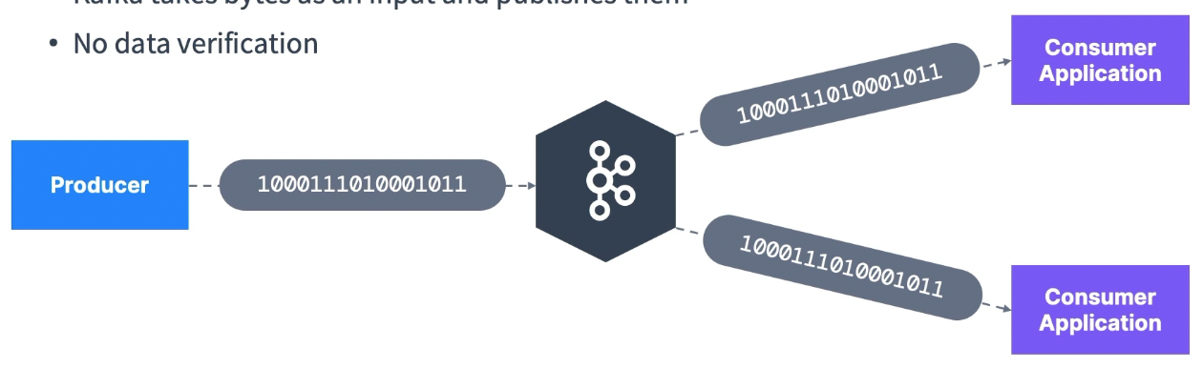
The need for a schema registry
Kafka takes bytes as an input and publishes them
No data verification
What if Producer sends bad data?
What if a field gets renamed?
What if the data format changes from one day to another?
The consumers break!!

Slide 9
The need for a schema registry
We need data to be self describable
We need to be able to evolve data without breaking downstream consumers
We need schemas… and a schema registry
What if the kafka brokers were verifying the messages they receive?
It would break what makes kafka so good
Kafka doesn’t parse or even read you dara (no CPU usage)
Kafka takes bytes as an input without even loading them into memory (Zero copy)
Kafka distributes bytes
As far as Kafka is concerned, its doesn’t even knw if your data is an integer, a string etc

Slide 10
The need for a schema registry
The schema registry must be a separate component
Producers and Consumers nee to be able to talk to it
The schema registry must be able to reject bad data
A common data format must be agreed upon
It nees to support schemas
It needs to support evolution
It needs to be lightweight
Enter.. The Schema Registry
And Apache Avro as the data format(Protobuf, JSON is supported)

Slide 11
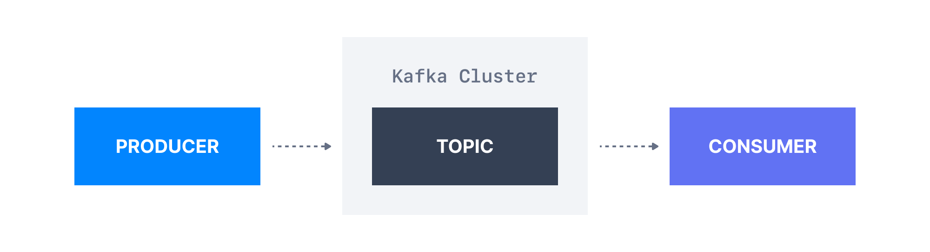
Pipeline without Schema Registry

Slide 12
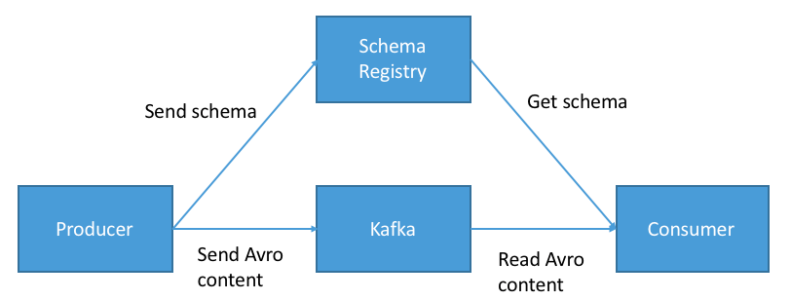
Schema Registry - Purpose
Store and retreive schemas for Producers/Consumers
Enforce Backward / Forward / Full compatibility on topics
Decrease the size of the payload of data sent to kafka

Slide 13
Schema Registry - Gotchas
Utilizing a schema registry has a lot of benefits
BUT it implies you need to
Set it up well
Make sure it’s highly available
Partially change the producer and consumer code
Apache Avro as a format has a learning curve
Other formats include protobuf and JSON Schema
The Confluent Schema Registry is free and source-available
Other open-source alternatives may exist

Slide 14
Kafka Connect

Slide 15
Why Kafka Connect
Kafka v0.9.x (Nov 2015)
Kafka Connect API was introduced
Interface for creating connectors
https://Confluent.io/hub
Four Common kafka use Cases
Source => Kafka – Producer API – Kafka Connect Source
Kafka => Kafka – Consumer & Producer API – Kafka Streams
Kafka => Sink – Consumer API – Kafka Connect Sink
Kafka => APP – Consumer API

Slide 16
Why Kafka Connect
Programmers always want to import data from the same sources:
Databases, JDBC, Blockchain, Cassandra, DynamoDB, CosmosDB, MongoDB, MQTT, Salesforce, Twitter etc…
Programmers always want to store data in the same sinks:
S3, ElasticSearch, HDFS, JDBC, SAP, DocumentDB, Cassandra, DynamoDB, MongoDB, Red etc…
It is tough to achieve fault tolerance, exactly once processing, distribution, ordering.
Other programmers may have already done a very good job!

Slide 17
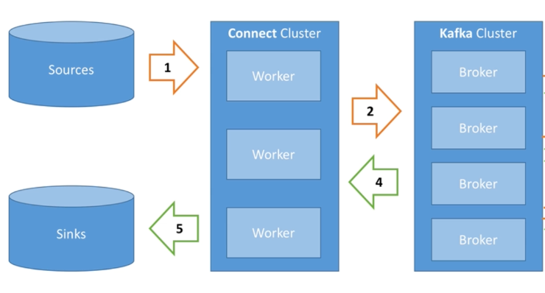
Kafka Connect - Architecture

Slide 18
Kafka Connect – High Level
Source Connectors to get data from common data sources
Sink Connectors to publish data to common data stores
Make it easy for non-experienced dev to quickly get their data reliably into Kafka
Can be part of your ETL pipeline
Scaling made easy with workers
Re-usable code!

Slide 19
Kafka Connect - Concepts
Kafka Conenct cluster has multiple loaded Connectors
Each connector is a re-usable piece of code (java jars)
Kafka Connect API – Spec for java connectors
Many conenctors exists in the open source world, leverage them!
Connect + User configuration => task
A task is linked to a connetor configuration
A job configuration may spawn multiple tasks
Tasks are executed by Kafka Connect Workers(Servers)
A woker is a single java process
A worker can be standalone or in a cluster

Slide 20
Kafka Connect - Distributed
Multiple workers run your connectors and tasks
Configuration is submitted using a REST API
Easy to scale, and fault tolerant (rebalancing in case a worker dies)
Useful for production deployment of connectors

Slide 21
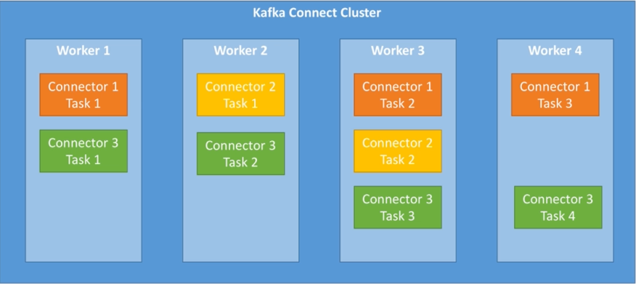
Kafka Connect – Distributed

Slide 22
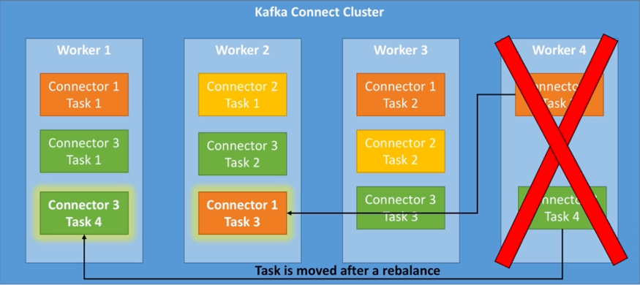
Kafka Connect – Distributed

Slide 23
Kafka Connect API & Rest Proxy
All the actions performed in the Kafka connect UI are actually triggering REST API calls to Kafka Connect.
The same can be done for Kafka itself through Kafka Rest Proxy
Simply explained it’s a API layer on top of Kafka
https://docs.confluent.io/platform/current/kafka-rest/api.html#crest-api-v2

Slide 24
Sources – since that is important now a days
https://www.udemy.com/course/apache-kafka/
https://www.udemy.com/course/kafka-connect/
https://www.conduktor.io/kafka/
Most of the kafka images are from here

Slide 25
Short break

